Slide 1

EEE5015: Machine Learning & Artificial Intelligence
Zhiyun Lin

Slide 2
Lecture 01: Introduction
Administration details
What is machine learning (ML) and why is it so cool?

Slide 3
The Team
Instructor:
Zhiyun Lin (林志赟)
Email:
linzy@sustech.edu.cn
Office:
701 South Tower, College of Engineering
TA:
Liang Zhu (朱梁)

Slide 4
Course Information
Lecture time and place:
Monday 10:20AM-12:10PM in the 3rd Lecture hall 409 (weekly)
Wednesday 8:00AM-9:50AM in the 3rd Lecture hall 409 (biweekly)
Instruction language:
English
Lecture Website:
https://bb.sustech.edu.cn/
Class Group WeChat

Slide 5
Pre-requisites
Liberal wrt waiving pre-requisites
But it is up to you to determine if you have the appropriate background
Do I have the appropriate background?
Linear algebra: vector/matrix manipulations, properties
Calculus: derivatives and partial derivatives
Probability: common distributions; Bayes Rule
Statistics: mean/median/mode; maximum likelihood
Programming language: Python

Slide 6
Textbook(s)
Textbook:
C. M. Bishop, Pattern Recognition and Machine Learning, Springer, 2006
R. S. Sutton and A. C. Barto, Reinforcement Learning: An Introduction (second edition), The MIT Press, 2018
Other recommending book:
A. Downey, Think Python (version 2.0), Green Tea Press, 2012
E-books are available in SUSTech Blackboard

Slide 7
Provisional Calendar (48 credit hours): Part I
Lecture 01. Introduction to machine learning
Lecture 02. Introduction to PyTorch: part I
Lecture 03. Introduction to PyTorch: part II
Lecture 04. Mathematics preliminaries in machine learning
Lecture 05. Regression
Lecture 06. Linear regression and linear classification (binary)
Lecture 07. Logistic regression and multi-class classification
Lecture 08. Multi-layer perceptrons

Slide 8
Provisional Calendar (48 credit hours): Part II
Lecture 09. Convolutional neural networks (CNNs)
Lecture 10. Recurrent neural networks (RNNs)
Lecture 11. Attention and transformer neural networks
Lecture 12. Reinforecement learning (RL) problem and RL agent
Lecture 13. Markov decision processes (MDP)
Lecture 14. Planning by dynamic programming
Lecture 15. Model-free prediction
Lecture 16. Model-free control

Slide 9
Provisional Calendar (48 credit hours): Part III
Lecture 17. Value function approximation
Lecture 18. Policy gradient
Lecture 19. Integrating learning and planning
Lecture 20. Exploration and exploitation
Lecture 21. Classic games
Lecture 22. Deep reinforcement learning: part I
Lecture 23. Deep reinforcement learning: part II
Lecture 24. Deep reinforcement learning: part III

Slide 10
Assessment
Class performance 10%:
Class attendance
In-class tests: one tiny problem each, randomly
Homework assignments: coding for small problems, totally 6+ (only 2 will be marked, randomly selected)
Mid-term project 20%:
One project: coding + paper-like project report
Using ML techniques learned in the first half semester
Final project 40%:
One project: coding + paper-like project report
Using ML techniques learned in the whole semester
Final exam 30%:
Paper and pencil with one A4 note sheet
All topics covered in the course

Slide 11
More on Assignments and Projects
Cheating is not permitted.
Violation of this policy is grounds for a semester grade of F, in accordance with university regulations.
Each student is responsible for his/her own assignments and projects.
Discussion of assignments and projects should be limited to clarification of the handout itself, and some possible ideas.
Copying pseudocode, codes or simulation results as a hand-in solution is not allowed.
The schedule of assignments and projects will be announced in SUSTech Blackboard.
Projects handed in later than the due time will receive 0 mark for that piece of work.
Assignments handed in later than the due time will be counted.

Slide 12
Learning Objectives
Upon completion of this course, you will ...
understand fundamental knowledge and concepts about machine learning and artificial intelligence
familiarize with broad classes of machine learning algorithms and related fundamental theory (neural networks and reinforement learning)
apply and adapt learned machine learning techniques to solve engineering problems and to your own research/thesis domain.

Slide 13
Ways of Study
In class
Concentrate on the lecture
Understand at least 70%, otherwise you may stop your lecture instructor to continue
Raise your questions to help your understanding
After class
Do reading!
Do coding!
Practice, Practice, and Practice, ......

Slide 14
Lecture 01: Introduction
Administration details
What is machine learning (ML) and why is it so cool?

Slide 15

What is Artificial Intelligence?
ChatGPT is a natural language processing tool driven by AI technology that allows you to have human-like conversations and much more with a chatbot. The language model can answer questions, and assist you with tasks such as composing emails, essays, and code.

Slide 16
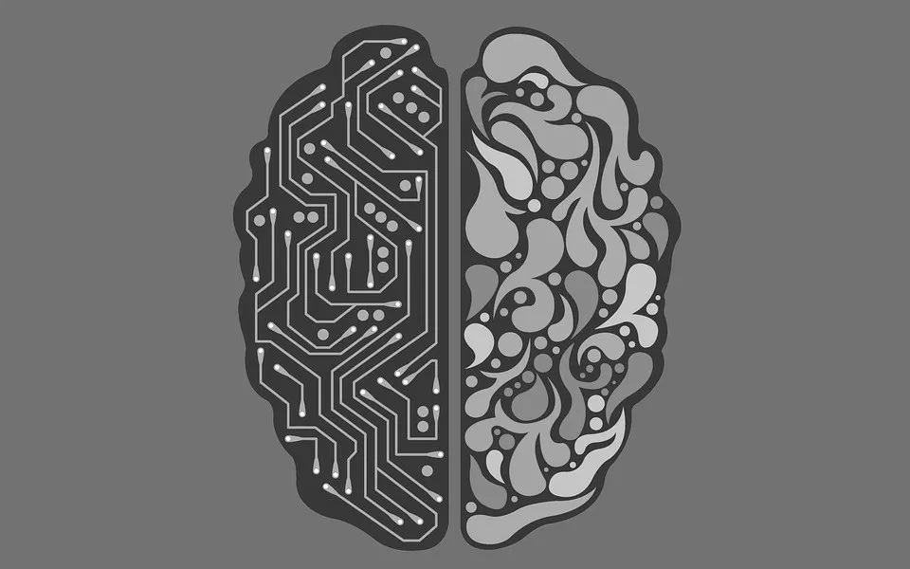
What is Artificial Intelligence?
Artificial intelligence (AI) is intelligence demonstrated by machines, as opposed to the natural intelligence displayed by animals including humans.
AI research has been defined as the field of study of intelligent agents, which refers to any system that perceives its environment and takes actions that maximize its chance of achieving its goals.
The term "artificial intelligence" had previously been used to describe machines that mimic and display "human" cognitive skills that are associated with the human mind, such as "learning" and "problem-solving". This definition has since been rejected by major AI researchers who now describe AI in terms of rationality and acting rationally, which does not limit how intelligence can be articulated.

Slide 17
Key Takeaways of AI
Artificial intelligence (AI) refers to the simulation or approximation of human intelligence in machines.
The goals of artificial intelligence include computer-enhanced learning, reasoning, and perception.
AI is being used today across different industries from finance to healthcare.
Weak AI tends to be simple and single-task oriented, while strong AI carries on tasks that are more complex and human-like.
Some critics fear that the extensive use of advanced AI can have a negative effect on society.

Slide 18
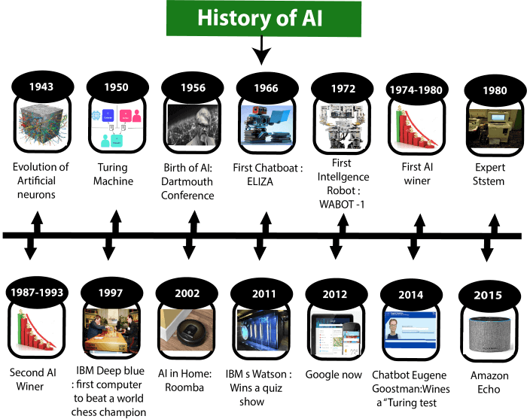
History of AI
Artificial Intelligence is not a new word and not a new technology for researchers. This technology is much older than you would imagine.

Slide 19
History of AI
Maturation of Artificial Intelligence (1943-1952)
Year 1943: The first work which is now recognized as AI was done by Warren McCulloch and Walter pits in 1943. They proposed a model of artificial neurons.
Year 1949: Donald Hebb demonstrated an updating rule for modifying the connection strength between neurons. His rule is now called Hebbian learning.
Year 1950: The Alan Turing who was an English mathematician and pioneered Machine learning in 1950. Alan Turing publishes "Computing Machinery and Intelligence" in which he proposed a test. The test can check the machine's ability to exhibit intelligent behavior equivalent to human intelligence, called a Turing test.

Slide 20
History of AI
The birth of Artificial Intelligence (1952-1956)
Year 1955: An Allen Newell and Herbert A. Simon created the "first artificial intelligence program" Which was named as "Logic Theorist". This program had proved 38 of 52 Mathematics theorems, and find new and more elegant proofs for some theorems.
Year 1956: The word "Artificial Intelligence" first adopted by American Computer scientist John McCarthy at the Dartmouth Conference. For the first time, AI coined as an academic field.
The golden years-Early enthusiasm (1956-1974)
Year 1966: The researchers emphasized developing algorithms which can solve mathematical problems. Joseph Weizenbaum created the first chatbot in 1966, which was named as ELIZA.
Year 1972: The first intelligent humanoid robot was built in Japan which was named as WABOT-1.

Slide 21
History of AI
The first AI winter (1974-1980)
The duration between years 1974 to 1980 was the first AI winter duration. AI winter refers to the time period where computer scientist dealt with a severe shortage of funding from government for AI researches.
During AI winters, an interest of publicity on artificial intelligence was decreased.
A boom of AI (1980-1987)
Year 1980: After AI winter duration, AI came back with "Expert System". Expert systems were programmed that emulate the decision-making ability of a human expert.
In the Year 1980, the first national conference of the American Association of Artificial Intelligence was held at Stanford University.

Slide 22
History of AI
The second AI winter (1987-1993)
The duration between the years 1987 to 1993 was the second AI Winter duration.
Again Investors and government stopped in funding for AI research as due to high cost but not efficient result. The expert system such as XCON was very cost effective.
The emergence of intelligent agents (1993-2011)
Year 1997: In the year 1997, IBM Deep Blue beats world chess champion, Gary Kasparov, and became the first computer to beat a world chess champion.
Year 2002: for the first time, AI entered the home in the form of Roomba, a vacuum cleaner.
Year 2006: AI came in the Business world till the year 2006. Companies like Facebook, Twitter, and Netflix also started using AI.

Slide 23
History of AI
Deep learning, big data and artificial general intelligence (2011-present)
2010: ImageNet launched the ImageNet Large Scale Visual Recognition Challenge (ILSVRC), their annual AI object recognition competition.
2011: Watson, a natural language question answering computer created by IBM, defeated two former Jeopardy! champions, Ken Jennings and Brad Rutter, in a televised game.
2014: Chatbot "Eugene Goostman" won a competition in the infamous "Turing test."
2015-2017: Google DeepMind’s AlphaGo, a computer program that plays the board game Go, defeated various (human) champions.
2021: AlphaFold: DeepMind’s protein-folding AI is transformational as understanding proteins and their complex 3D shapes is key to understanding life, and especially for developing drugs

Slide 24
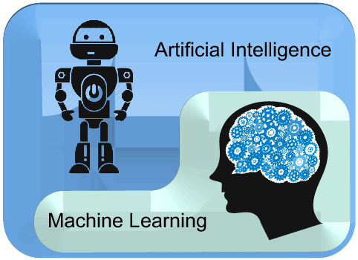
Machine Learning ≠ Artificial Intelligence
AI is a bigger concept to create intelligent machines that can simulate human thinking capability and behavior
Machine learning is an application or subset of AI that allows machines to learn from data without being programmed explicitly

Slide 25
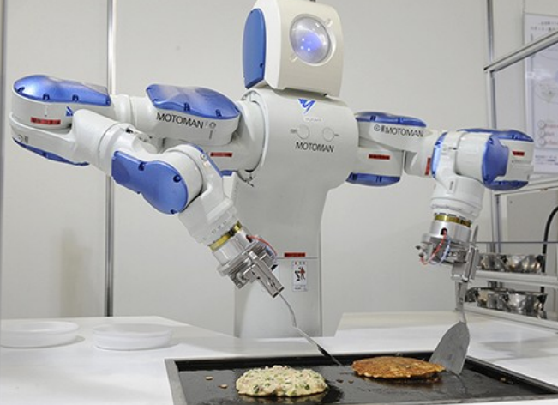
What is Machine Learning?
How can we solve a specific problem?
As computer scientists, we write a program that encodes a set of rules that are useful to solve the problem
Figure : Make a robot cook

Slide 26
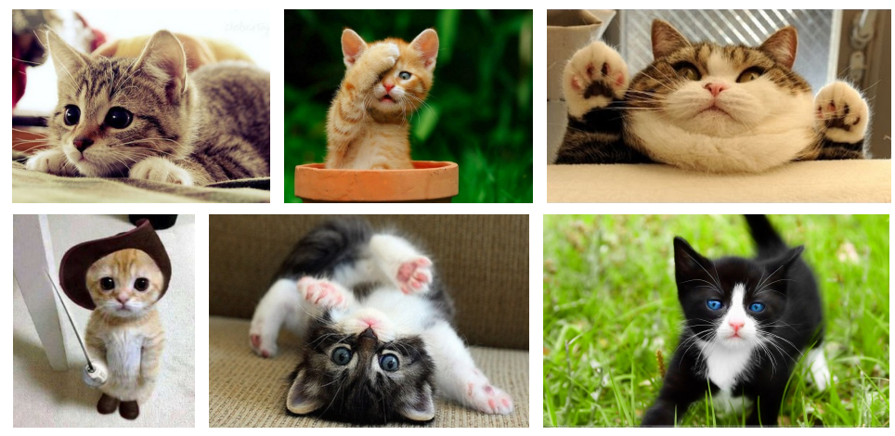
What is Machine Learning?
How can we solve a specific problem?
As computer scientists, we write a program that encodes a set of rules that are useful to solve the problem
But In many cases it is very difficult to specify those rules, e.g., given a picture determine whether there is a cat in the image

Slide 27
What is Machine Learning?
Learning systems are not directly programmed to solve a problem, instead, they develop own program (rules) based on:
Examples of how they should behave
From trial-and-error experience trying to solve the problem
Different than standard CS:
Want to implement unknown function, only have access e.g., to sample input-output pairs (training examples)
Learning simply means incorporating information from the training examples into the system

Slide 28
Tasks that requires machine learning: Recognizing a cat!
Machine learn to classify a cat picture
Offer a large number of cat pictures with labels and train a model
Use the trained model to predict where there is a cat or not for any given picture

Slide 29
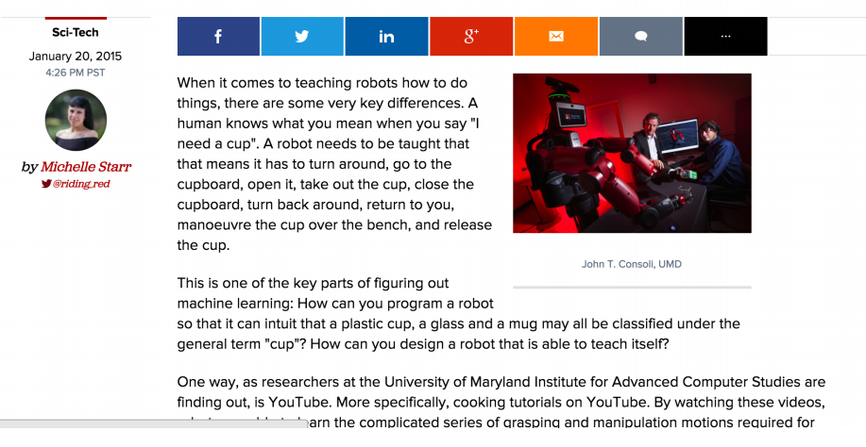
Tasks that benefits from machine learning: cooking!
Robots learn to cook by watching YouTube
When it comes to learning how to cook, it turns out that robots may not be so different from humans after all... or are they?

Slide 30
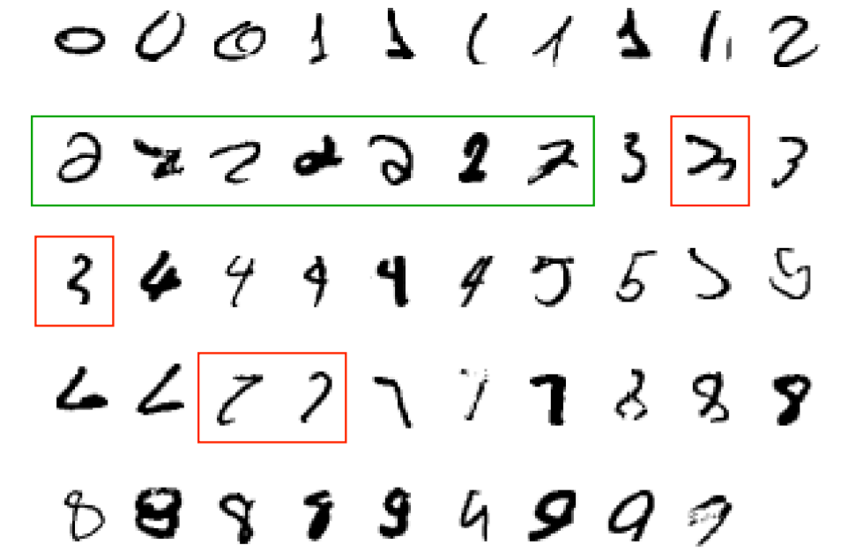
Why use learning?
It is very hard to write programs that solve problems like recognizing a handwritten digit
What distinguishes a 2 from a 7?

Slide 31
Why use learning?
It is very hard to write programs that solve problems like recognizing a handwritten digit
What distinguishes a 2 from a 7?
How does our brain do it?
Instead of writing a program by hand, we collect examples that specify the correct output for a given input
A machine learning algorithm then takes these examples and produces a program that does the job
The program produced by the learning algorithm may look very different from a typical hand-written program. It may contain millions of numbers.
If we do it right, the program works for new cases as well as the ones we trained it on.

Slide 32
Learning algorithms are useful in many tasks
1. Classification: Determine which discrete category the example is

Slide 33
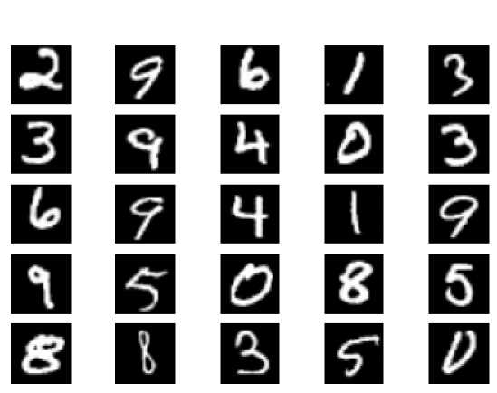
Examples of Classification
What digit is this?

Slide 34
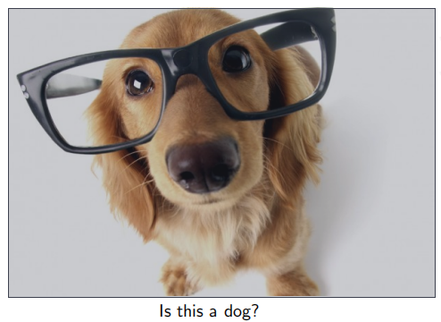
Examples of Classification

Slide 35
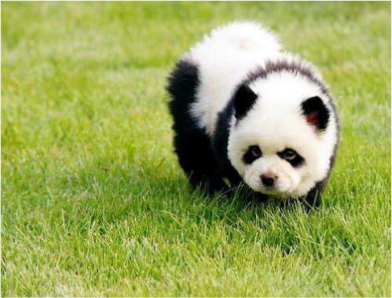
Examples of Classification
What about this one?

Slide 36

Examples of Classification
Am I going to pass the exam?

Slide 37
Learning algorithms are useful in many tasks
1. Classification: Determine which discrete category the example is
2. Recognizing patterns: Speech recognition, facial identity, etc

Slide 38
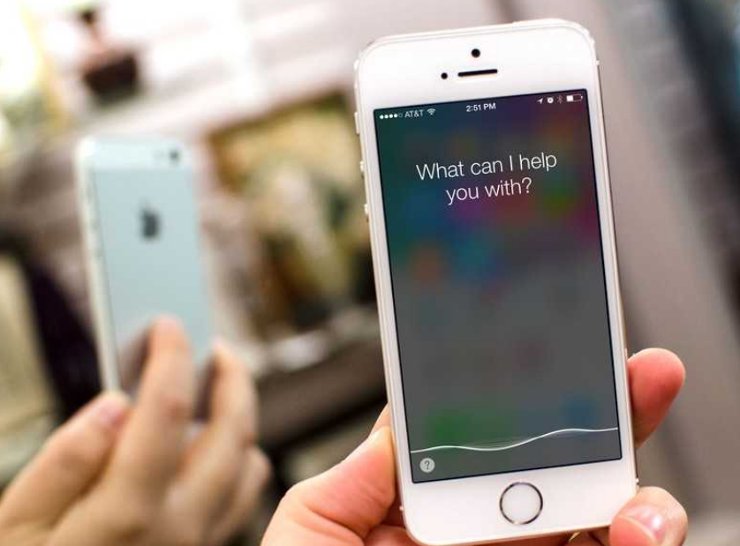
Examples of Recognizing Patterns
Siri supports a wide range of user commands, including performing phone actions, checking basic information, scheduling events and reminders. Its speech recognition engine uses advanced machine learning technologies to function.

Slide 39
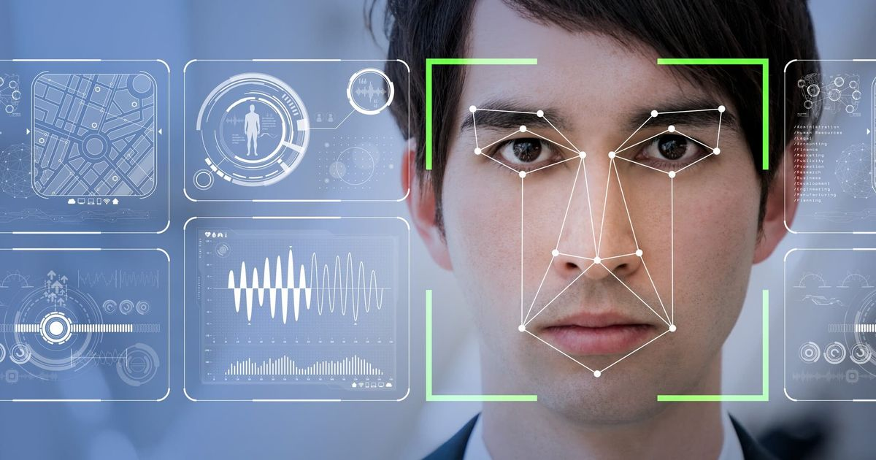
Examples of Recognizing Patterns
Facial recognition system: Matching a human face from a digital image or a video frame against a database of faces, typically employed to authenticate users through ID verification services, works by pinpointing and measuring facial features from a given image.

Slide 40
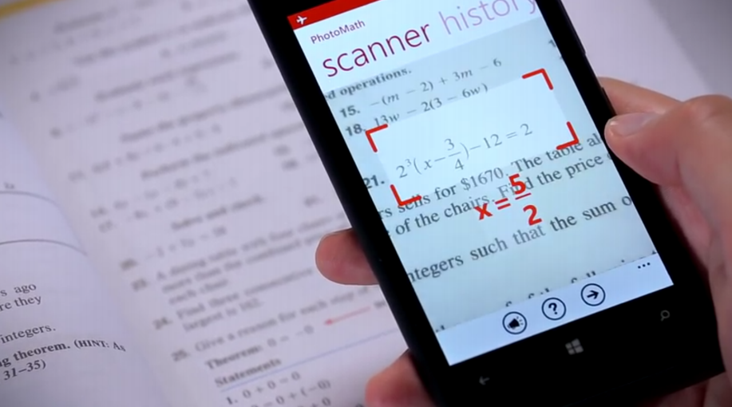
Examples of Recognizing Patterns
Figure : Photomath: https://photomath.net/
Photomath is a mobile computer algebra system with an augmented optical character recognition system designed for use with a smartphone's camera to scan and recognize mathematical equations.

Slide 41
Learning algorithms are useful in other tasks
1. Classification: Determine which discrete category the example is
2. Recognizing patterns: Speech Recognition, facial identity, etc
3. Recommender systems: Noisy data, commercial pay-off (e.g., TikTok, Taobao, Amazon, Netflix).

Slide 42
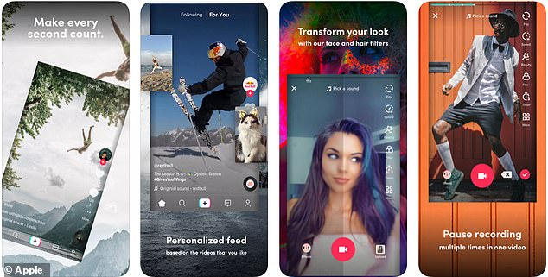
Examples of Recommendation Systems
How TikTok recommends videos #ForYou

Slide 43

Examples of Recommendation Systems
Aims at providing users with attention-grabbing items based on their preferences in Taobao

Slide 44
Learning algorithms are useful in other tasks
1. Classification: Determine which discrete category the example is
2. Recognizing patterns: Speech Recognition, facial identity, etc
3. Recommender systems: Noisy data, commercial pay-off (e.g., TikTok, Taobao).
4. Information retrieval: Find documents or images with similar content

Slide 45
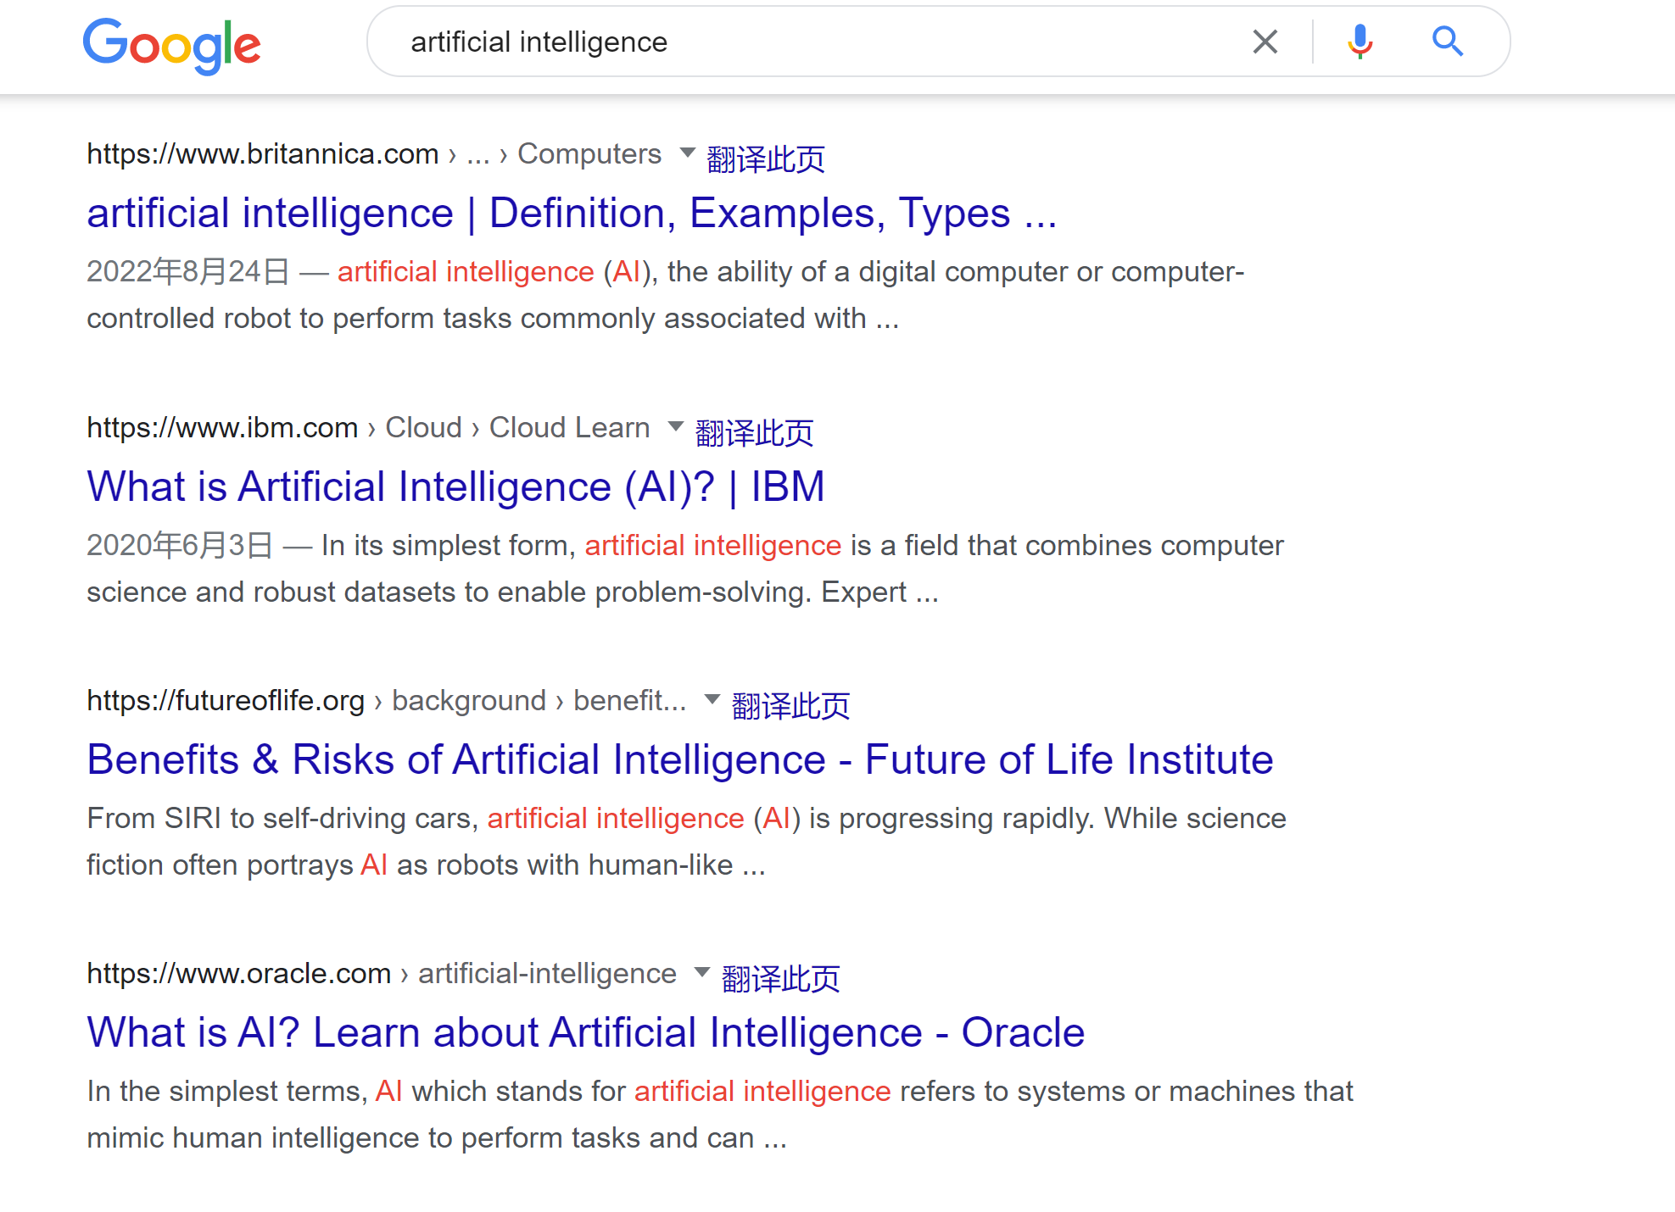
Examples of Information Retrieval

Slide 46
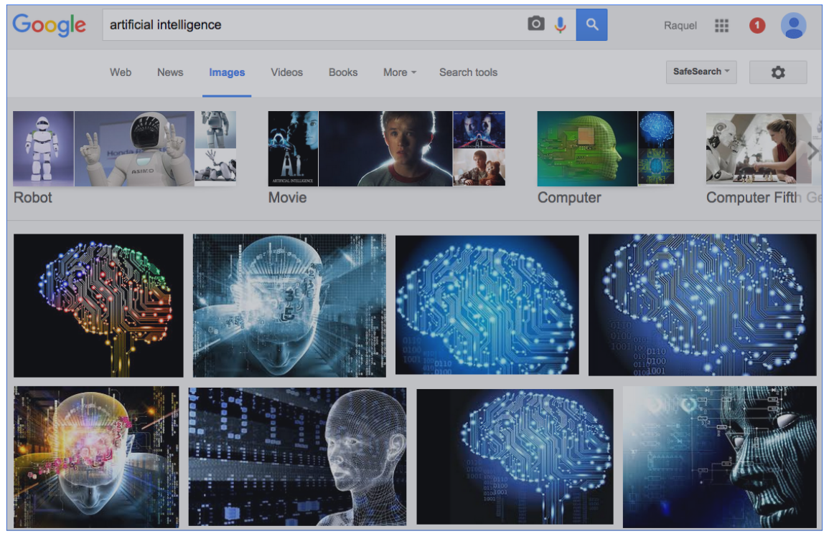
Examples of Information Retrieval

Slide 47
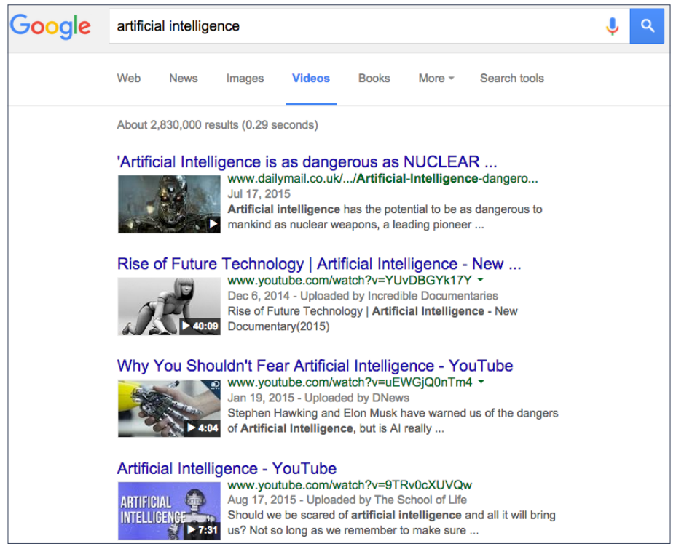
Examples of Information Retrieval

Slide 48
Learning algorithms are useful in other tasks
1. Classification: Determine which discrete category the example is
2. Recognizing patterns: Speech Recognition, facial identity, etc
3. Recommender systems: Noisy data, commercial pay-off (e.g., TikTok, Taobao).
4. Information retrieval: Find documents or images with similar content
5. Computer vision: detection, segmentation, depth estimation, optical flow, etc

Slide 49

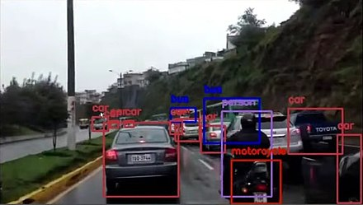
Computer Vision
Object detection: deals with detecting instances of semantic objects of a certain class (such as humans, buildings, or cars) in digital images and videos.
Objects detected with OpenCV's Deep Neural Network module (dnn) by using a YOLOv3 model capable to detect objects of 80 common classes.
Detection of objects on a road

Slide 50
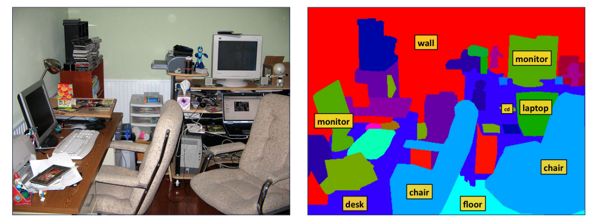
Computer Vision
Image segmentation: partition a digital image into multiple image segments (sets of pixels). The goal of segmentation is to simplify and/or change the representation of an image into something that is more meaningful and easier to analyze.

Slide 51
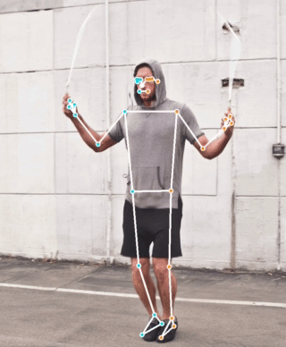
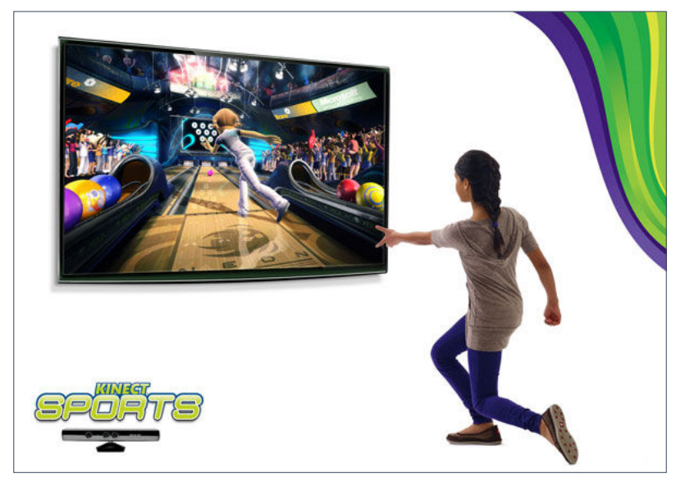
Computer Vision
By using RGB-D camera, estimate a human pose

Slide 52
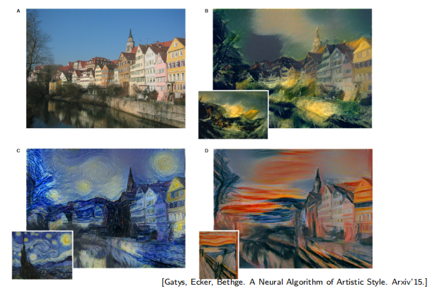
Computer Vision
Convert a picture with artistic styles

Slide 53
Learning algorithms are useful in other tasks
1. Classification: Determine which discrete category the example is
2. Recognizing patterns: Speech Recognition, facial identity, etc
3. Recommender systems: Noisy data, commercial pay-off (e.g., TikTok, Taobao).
4. Information retrieval: Find documents or images with similar content
5. Computer vision: detection, segmentation, depth estimation, optical flow, etc
6. Robotics: perception, planning, etc

Slide 54
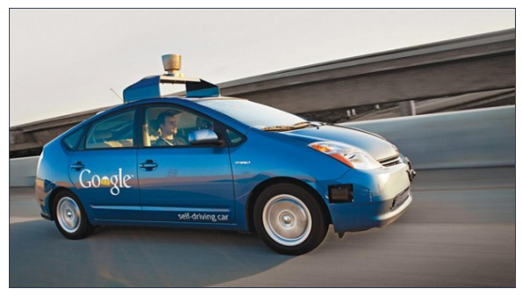
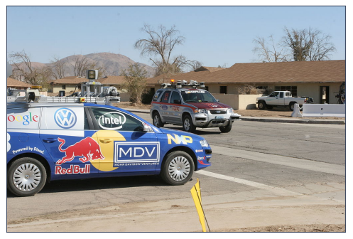
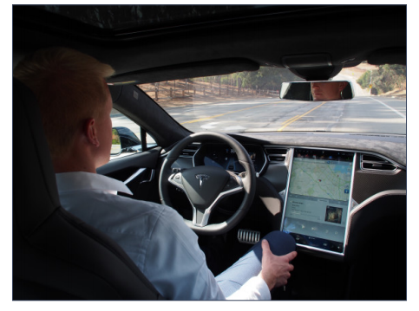
Autonomous Driving
A self-driving car (also known as an autonomous car or driverless car) is a vehicle that uses a different number of sensors, radars, cameras, and artificial intelligence to travel to destinations without needing a human driver. In many aspects, it uses artificial intelligence techniques to make cars self-driving.

Slide 55
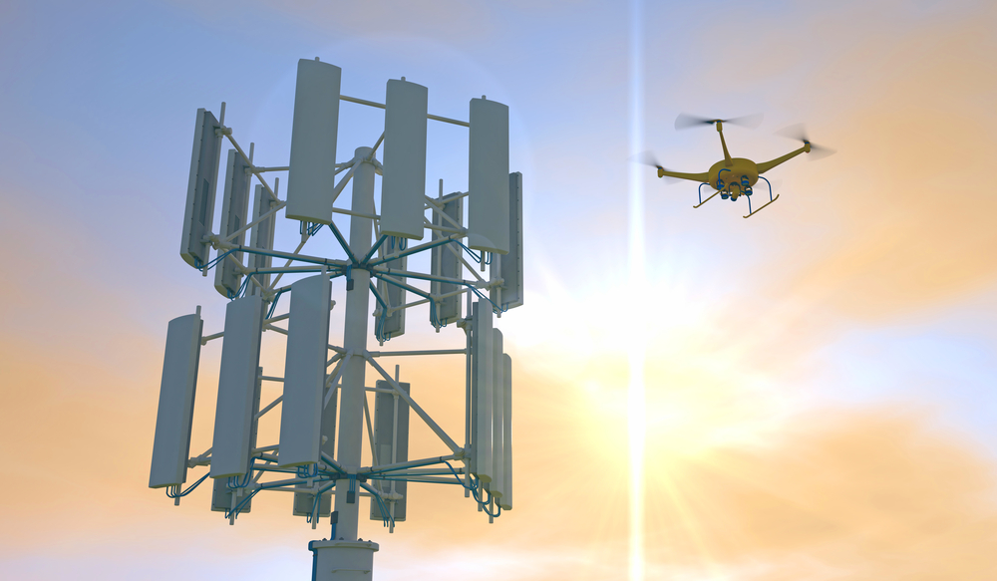
Flying Robots
A deep learning neural network helps drones sift through crowds to find and identify persons of interest. It can even inspect large industrial equipment, like telephone towers, and generate a real-time damage report.

Slide 56
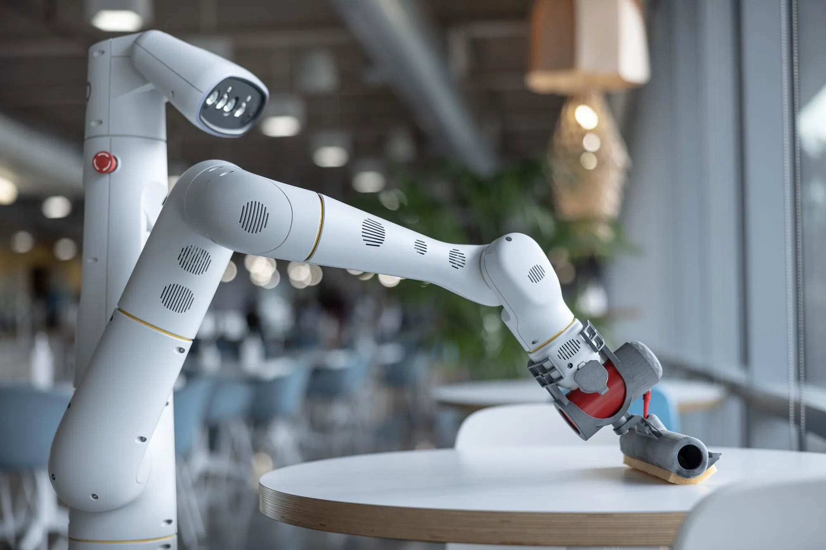
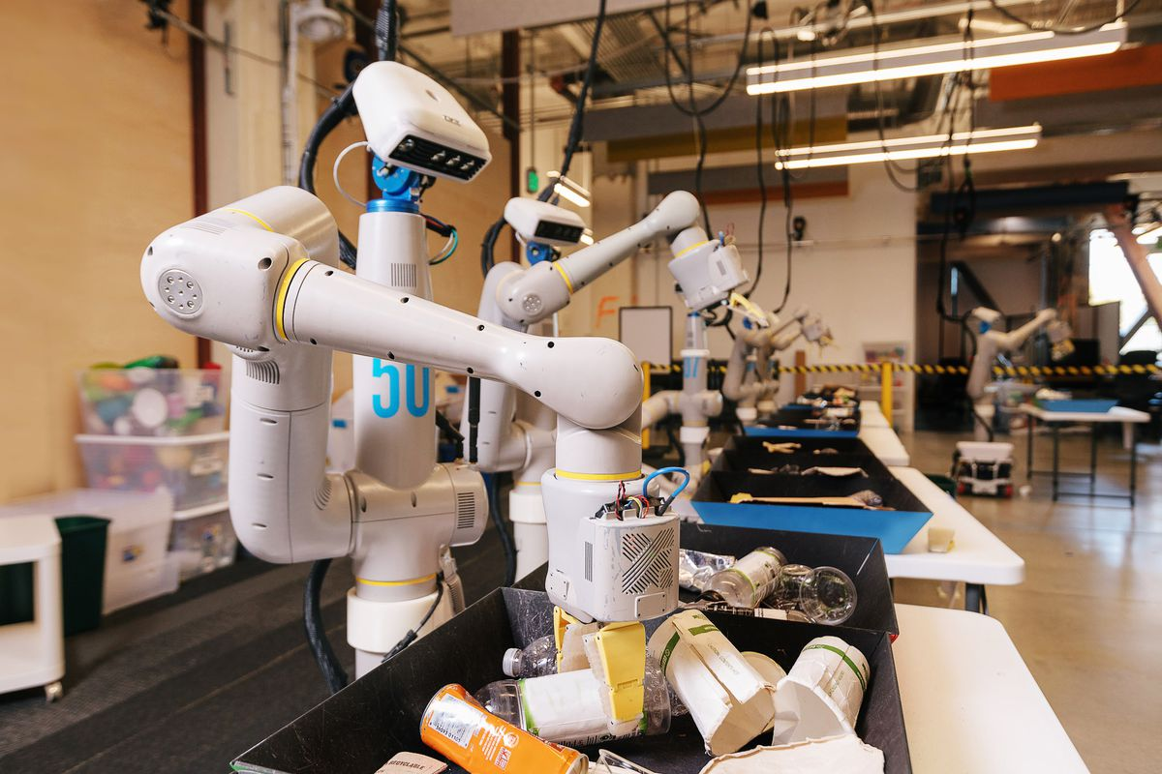
Everyday Robots
Today, robots are expensive and perform highly specialized tasks. But what if a robot could be affordable and taught by just about anyone?
The everyday robot project creates a robot that can be taught by anyone requires tackling some of the hardest challenges in the field of robotics.They could help people with whatever they needed, doing tasks we haven't even dreamed up yet.

Slide 57
Learning algorithms are useful in other tasks
1. Classification: Determine which discrete category the example is
2. Recognizing patterns: Speech Recognition, facial identity, etc
3. Recommender Systems: Noisy data, commercial pay-off (e.g., Amazon, Netflix).
4. Information retrieval: Find documents or images with similar content
5. Computer vision: detection, segmentation, depth estimation, optical flow, etc
6. Robotics: perception, planning, etc
7. Learning to play games

Slide 58
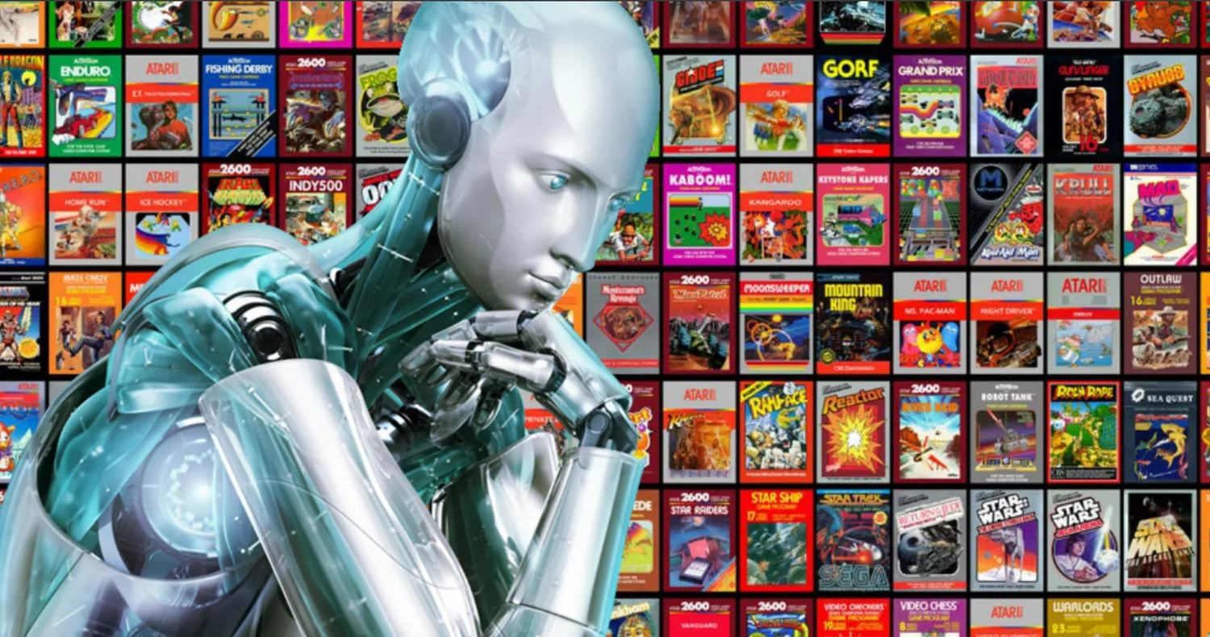
Playing Games: Atari
Researchers at Google's DeepMind have produced a reinforcement learning (RL) system called Agent57 that has scored above the human benchmark on all 57 Atari 2600 games
Agent57 uses machine learning called deep reinforcement, which allows it to learn from mistakes and keep improving over time.

Slide 59
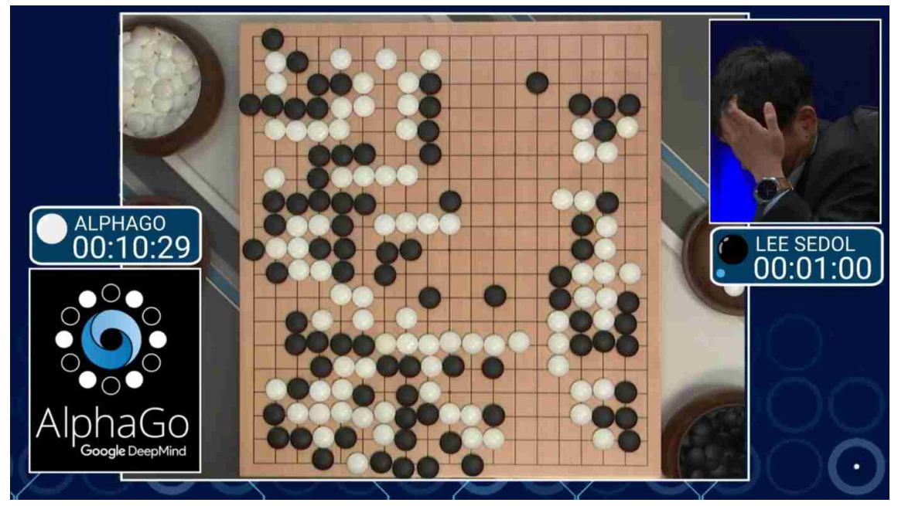
Playing Games: AlphaGo
AlphaGo is the first AI program to defeat a professional human Go player, the first to defeat a Go world champion, and is arguably the strongest Go player in history.

Slide 60
Learning algorithms are useful in other tasks
1. Classification: Determine which discrete category the example is
2. Recognizing patterns: Speech Recognition, facial identity, etc
3. Recommender Systems: Noisy data, commercial pay-off (e.g., Amazon, Netflix).
4. Information retrieval: Find documents or images with similar content
5. Computer vision: detection, segmentation, depth estimation, optical flow, etc
6. Robotics: perception, planning, etc
7. Learning to play games
8. Recognizing anomalies: Unusual sequences of credit card transactions, panic situation at an airport

Slide 61
Learning algorithms are useful in other tasks
1. Classification: Determine which discrete category the example is
2. Recognizing patterns: Speech Recognition, facial identity, etc
3. Recommender Systems: Noisy data, commercial pay-off (e.g., Amazon, Netflix).
4. Information retrieval: Find documents or images with similar content
5. Computer vision: detection, segmentation, depth estimation, optical flow, etc
6. Robotics: perception, planning, etc
7. Learning to play games
8. Recognizing anomalies: Unusual sequences of credit card transactions, panic situation at an airport
9. Spam filtering, fraud detection: The enemy adapts so we must adapt too

Slide 62
Learning algorithms are useful in other tasks
1. Classification: Determine which discrete category the example is
2. Recognizing patterns: Speech Recognition, facial identity, etc
3. Recommender Systems: Noisy data, commercial pay-off (e.g., Amazon, Netflix).
4. Information retrieval: Find documents or images with similar content
5. Computer vision: detection, segmentation, depth estimation, optical flow, etc
6. Robotics: perception, planning, etc
7. Learning to play games
8. Recognizing anomalies: Unusual sequences of credit card transactions, panic situation at an airport
9. Spam filtering, fraud detection: The enemy adapts so we must adapt too
10. Many more!

Slide 63
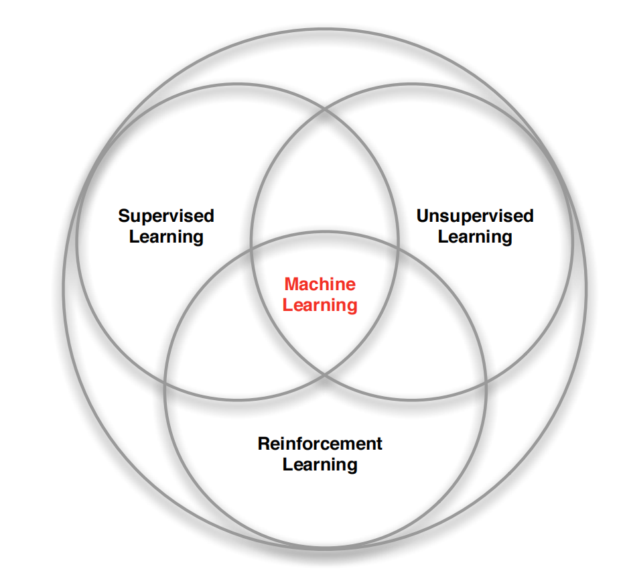
Branches of Machine Learning

Slide 64
Types of learning tasks
Supervised learning:
Require a training set of example inputs and their corresponding desired outputs, which the algorithm uses to learn a model of the mapping from inputs to outputs.
After the model is learned, the algorithm can generate outputs for new inputs.
Classification: 1-of-N output (speech recognition, object recognition, medical diagnosis)
Regression: real-valued output (predicting market prices, customer rating)

Slide 65
Types of learning tasks
Unsupervised learning:
Do not require a training set, but instead, learn a model of the input data by detecting patterns in it.
Unsupervised learning algorithms can be used to discover structure in data or to cluster data into groups.
Examples: Form clusters; Extract features

Slide 66
Extension of supervised and unsupervised learning
Self-supervised learning:
Require only a training set of input data; the desired outputs are not provided.
Instead, the algorithm learns a model of the input data and the desired outputs by detecting patterns in the data.
Semi-supervised learning:
Require a training set of input data and a set of desired outputs, but not all of the input data has to have a corresponding desired output.
The algorithm uses the input data to learn a model of the mapping from inputs to outputs and then uses the set of desired outputs to refine the model.

Slide 67
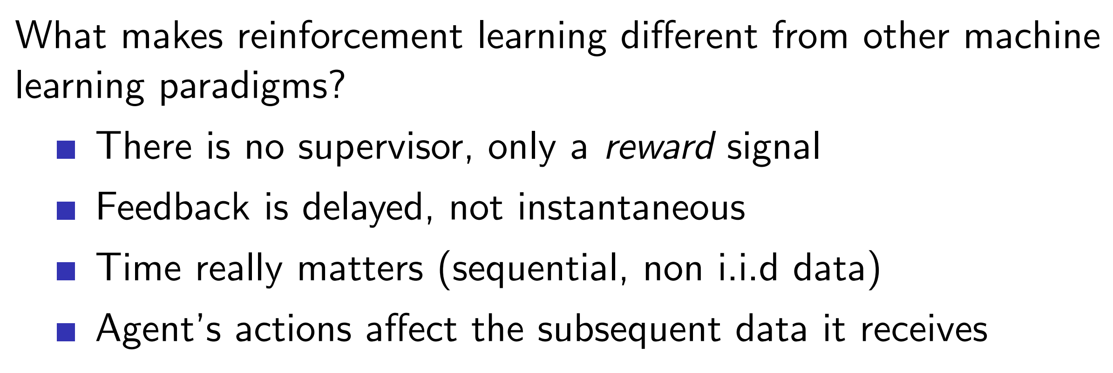
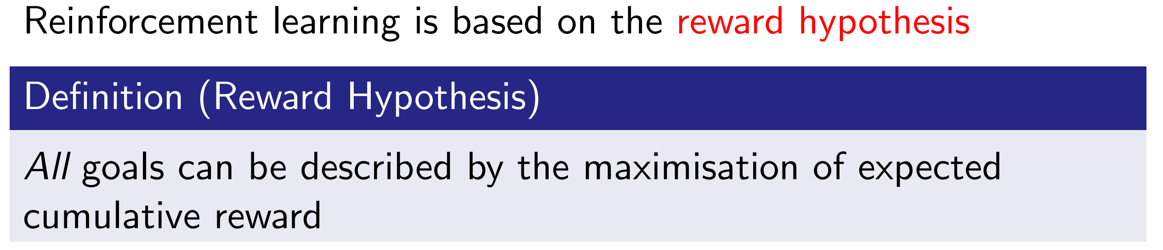
Types of learning tasks
Reinforcement learning:

Slide 68
Install Python
Install Anaconda
Anaconda is a distribution of the Python and R programming languages for scientific computing (data science, machine learning applications, large-scale data processing, predictive analytics, etc.), that aims to simplify package management and deployment.
Download the right version from https://www.anaconda.com/
After installing Anaconda, you will notice the following in the start-up menu (under “Anaconda3” folder)
Anaconda Powershell Prompt
Jupyter Notebook (Jupyter is a very popular application used for data analysis. It's an IPython notebook ("interactive python"). You can run each block of code separately.)
Spyder (Spyder is an Integrated Development Environment (IDE) for Python like Atom, Visual Studio, etc. )

Slide 69
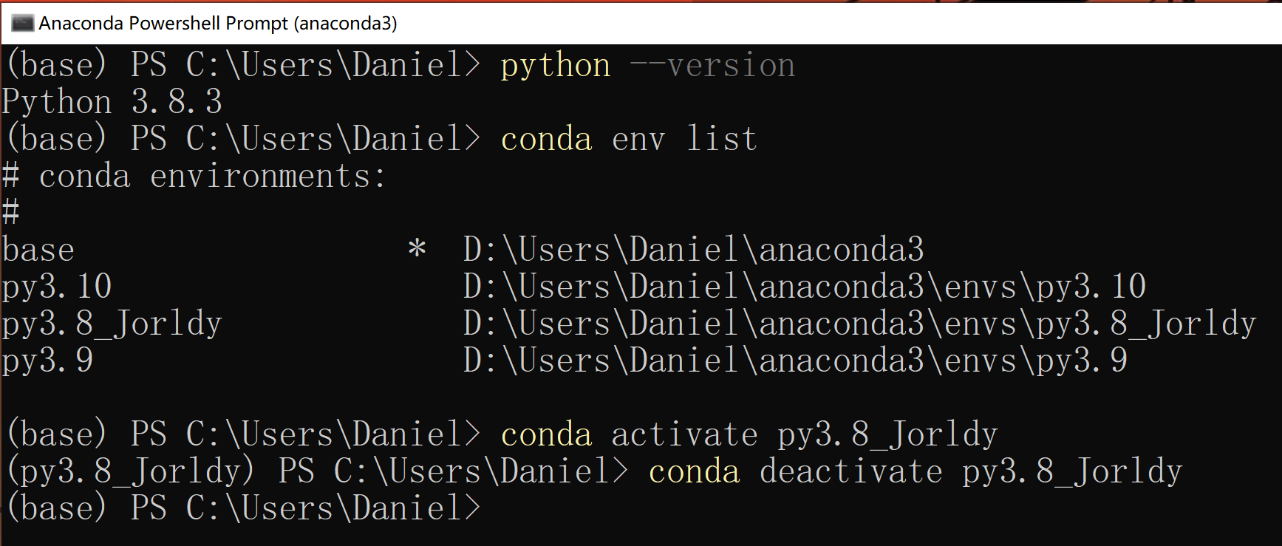
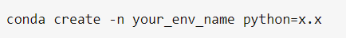
Install Python (cont’d)
Open “Anaconda Powershell Prompt”
Manage Python environment with conda

Slide 70
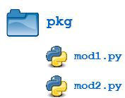
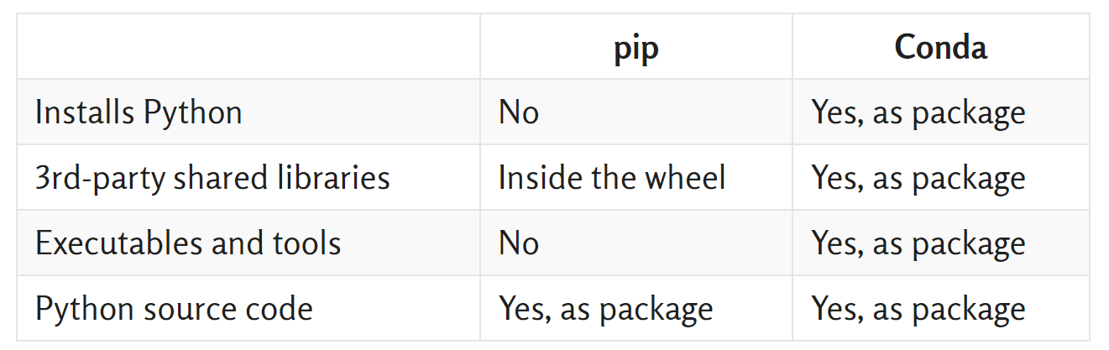
Install Python (cont’d)
Python Packages:
Suppose you have developed a very large application that includes many modules. Packages allow for a hierarchical structuring of the module namespace using dot notation.
Creating a package is quite straightforward, since it makes use of the operating system’s inherent hierarchical file structure.
Install Python Packages (e.g., NumPy: the core library for scientific computing in Python)
conda install xxx
pip install xxx

Slide 71
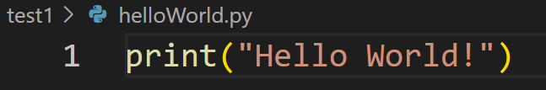
Edit and Run Python Code
Spyder (an IDE for Python)
Python file: xx.py
VS Code (suggest! Visual Studio Code is a code editor redefined and optimized for building and debugging modern web and cloud applications. )
https://code.visualstudio.com/
How to run Python code
pyhton xxx.py
Jupyter Notebook (Interactive python)
IPython file: xx.ipynb
Convert xx.ipynb to xx.py: Download as Python (.py)
run xx.py into an IPython notebook cell: %run xx.py

Slide 72
Homework Assignment
To have the Python environment and packages ready on your computer
Install Anaconda (Windows/Linux OS)
Create a virtual environment and install Python (suggest Python version 3.7, 3.8, or 3.9)
Install required packages: numpy, scipy, scikit-learn, matplotlib
Take a screen shot for the following
conda env list
activate your environment and python --version
show that all above packages are installed by using the command pip show xxx (xxx refers to the package name above)
Install VS code and get familiar with the use of VS code as well as Jupyter Notebook
Take a screen shot for the following
Edit a simple sample xx.py file using VS code
Run the python script in VS code terminal and show the output
Edit a simple sample xx.ipynb file using Jupyter Notebook
Run the cell in the iPython file and show the output

